Slide 2
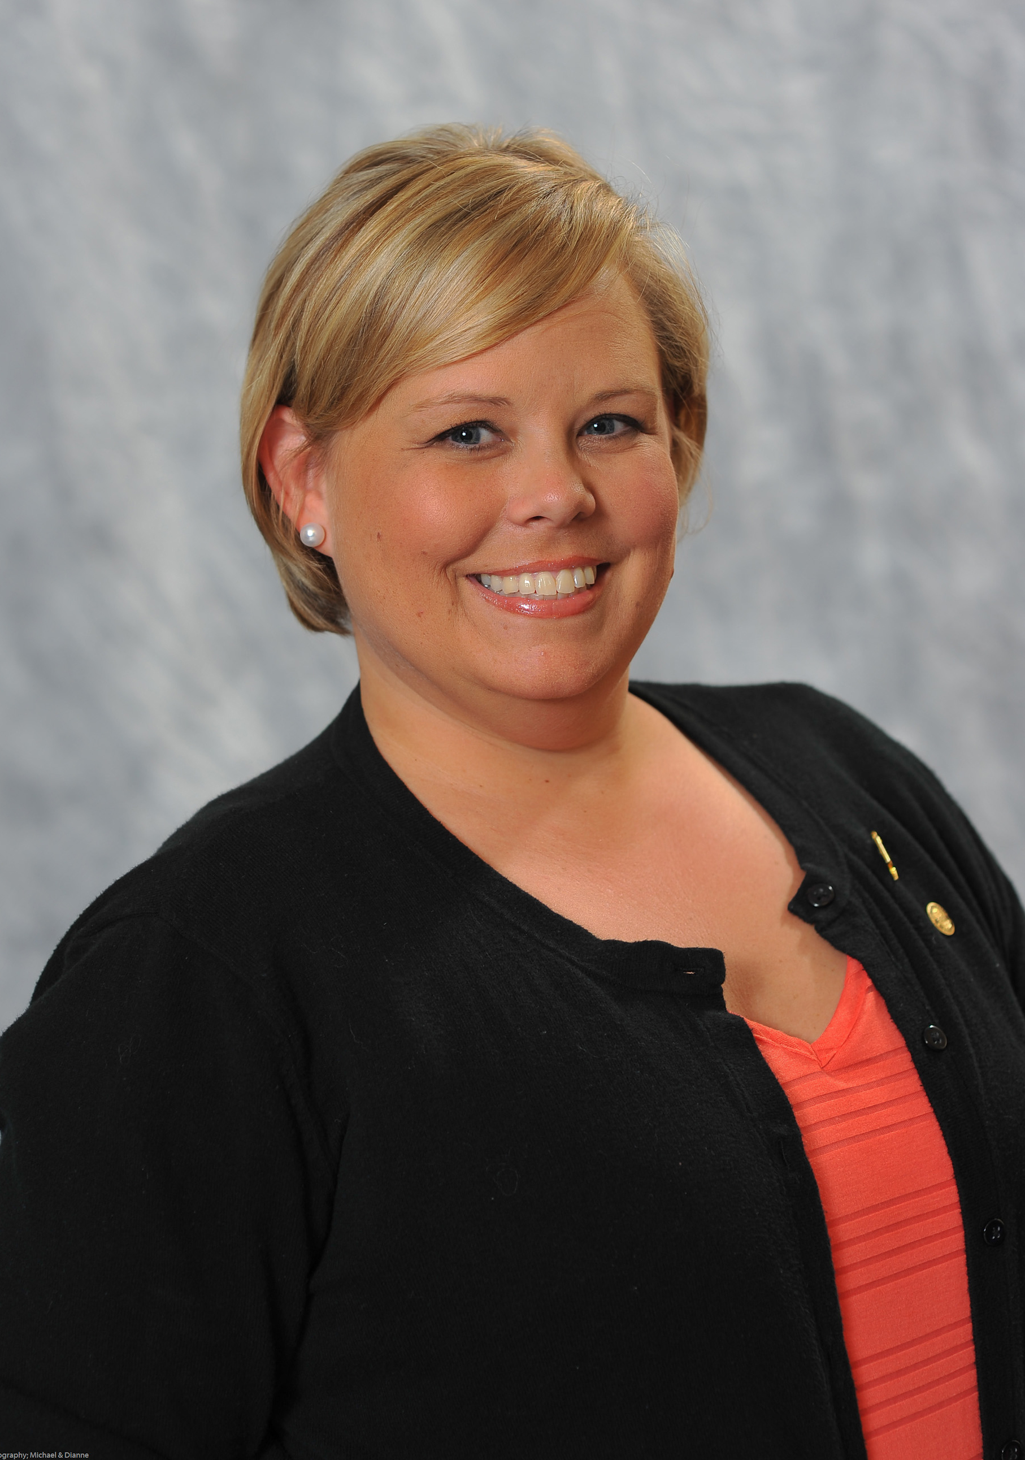
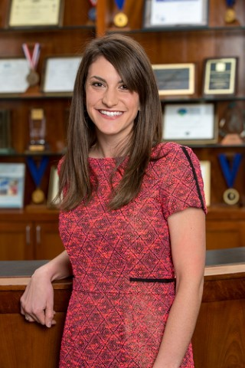
College Project Best Practices
Cassie Bryant
Executive Assistant &
Special Initiatives Coordinator
Phi Theta Kappa
Dr. Molly Harris
Advisor
Omicron Psi Chapter
Grayson College
Mary Linder
Advisor
Omicron Psi Chapter
Grayson College

Slide 3
Purpose
Establish and/or strengthen a supportive relationship between the chapter and the college administration
Chapter should meet with college president (or other appropriate administrator) to determine the College Project
College Project should support the college’s mission

Slide 4
Application
Word count: 1200 words
Essay questions
Briefly describe your CP & who from the chapter & college administration was involved in determining it?
Summarize your objectives for the CP & the process by which the chapter & college administration set these objectives.

Slide 5
Application
Essay questions (con’t)
Describe the planning process & strategies developed to complete the CP.
What were the quantitative & qualitative outcomes of your project, including the lessons learned by chapter members & others?
What is left undone or what opportunities remain for the future?

Slide 6
Judging
Maximum score: 45 points
Categories
Preparation – up to 10 points
Leadership Development – up to 10 points
Cooperative Effort/Communications – up to 10 points
Impact – up to 10 points
Presentation – up to 5 points
Deadline: January 25, 2017 at 5pm CST

Slide 7
Tips from the Trenches
Focus on the Process
Emphasis is on Communication
Intentional
Continuous/On-Going
Be Intentional about Leadership Development
Review College’s Mission, Strategic Plan, QEP, Etc.
Journal Individually

Slide 8
Writing Reminders
Answer the Question
Use the Rubric as a Guide
Outcomes
Qualitative
Quantitative
Be Specific
Who’d you meet with?
Who did what?
Why were decisions/choices made?

Slide 9
What goes where?
 | Preparation | Leadership Development | Cooperative Effort/Communications | Impact | Presentation
Q1 | X | X | X | X | X
Q2 | X | X | X | X | X
Q3 | X | X | X |  | X
Q4 | X | X | X | X | X
Q5 |  | X |  | X | X

Slide 10
Edit Extensively
Set an Early Deadline
Use Cloud-Based Storage
Peer Edit
Track Changes
Read it Out Loud
Advisor Edit
Outsider Edit

Slide 11
Submitting Successfully
Save Work in Rich Text Format
Review Uploaded Entry Prior to Submission
Submit Early
Advisor Certifies Entry
Contact Advisor Receives Confirmation

Slide 12
Q & A

Slide 13
THANK YOU TO OUR GENEROUS SPONSORS:

