Slide 1
Notes:
Five Star Competitive Edge is Phi Theta Kappa’s EXCLUSIVE professional development online course for members, alumni and advisors.

Slide 2
Purpose
A professional development plan to enhance your marketable skills to make you more competitive for scholarships, transferring and careers.
Notes:
Five Star Competitive Edge is Phi Theta Kappa’s EXCLUSIVE professional development online course for members, alumni and advisors.

Slide 3
Why Participate?
To strengthen your soft skills
To create a career development plan
To gain a competitive advantage!
Notes:
So why should you participate?
To strengthen the skills that are highly sought-after by employers and colleges alike … we’ll talk about specific skills in just a moment.
To create a Career Development Plan – from beginning to end. What does it take to reach your goals? Find out steps you need to take to achieve your dream job.

Slide 4
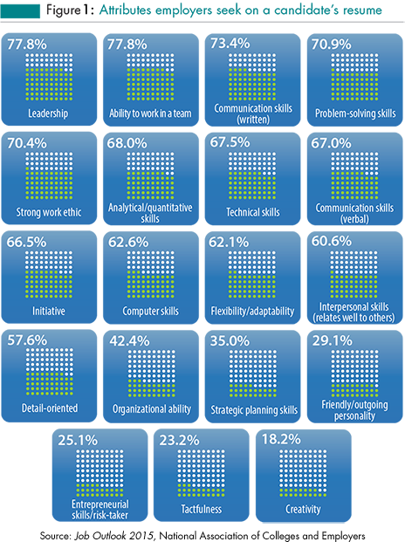
Notes:
Why is Competitive Edge focused on soft skills? Because employers highly rate “soft skills” as necessary for successful employees – no matter what the job is. This is a recent survey conducted by National Association of Colleges and Employers in which employers noted the attributes they’re looking for in potential job candidates. These skills are also valuable in completing your college goals. In fact, these can also be referred to as “life skills” as they are useful no matter what the setting.

Slide 5
Competitive Edge focuses on…
Communication skills
Interpersonal skills
Critical thinking/research skills
Cultural awareness
Planning/organizing
Emotional Intelligence
Professional Etiquette
Notes:
As you can see from this list, your college classes are only part of your education. Soft skills – such as oral and written communication, professional etiquette, emotional intelligence, critical thinking – are just as important, and can give you an edge over others when competing for jobs, scholarships and admission into four-year colleges.

Slide 6
Competitive Edge Course
Log in at getanedge.ptk.org
Self-paced
Five Star Members may participate, but not necessary to maintain status
Open to advisors and alumni
Notes:
Competitive Edge is an online course. It’s built on a learning management system or LMS just like other online courses. You can log in using your Phi Theta Kappa username and password at getanedge.ptk.org. There is also a link on the Competitive Edge webpage at ptk.org that takes you to the online course.
Members may move through the five levels (think: five units) at their own pace.
Current Five Star Members may participate again if they wish, but they retain their existing Five Star status no matter what. At this point, there is not an ADDITIONAL status for those who complete Competitive Edge again. There is new content in the new Competitive Edge, but there are videos/quizzes and a few activities that are from the original version.

Slide 7
Competitive Edge Components
Readings
Videos
Quizzes
Activities to practice your skills
Personal Reflection Journal
Notes:
Competitive Edge still consists of five levels. But the new version doesn’t have a complicated points system. Think of each level as a unit. Each unit consists of readings and/or videos related to Soft Skill Topics. After each video, you will take a short quiz to test your comprehension of that topic. You must score 100% on each quiz to receive credit, but you are not penalized for multiple attempts.
Other activities are assigned that will allow you to practice soft skills – such as writing an essay, writing a response to an irate customer, creating an Honors Case Study based on a current issue related to our Honors Study Topic, and giving a speech.
A very important part of this course is written reflection. You will create your own electronic Personal Reflection Journal using any software you like (Word doc, iPad Notes, etc.) Reflecting by writing allows you to process what you’re learning -- to make connections you didn’t see before -- so that you are much more likely to REMEMBER what you’ve learned.

Slide 8
Video Examples
Good Writing in a Techno World
Making Presentations
Overcoming Speech Anxiety
Critical Thinking
Researching Anything
Body Language
Professional Etiquette
Notes:
Examples of the instructional videos include good writing skills in a techno world, making presentations, overcoming speech anxiety, critical thinking, researching anything (basics of academic research), body language, professional etiquette including professional dress, dining etiquette, meeting etiquette and even social media etiquette. An extensive video library gives you access to even more professional development topics.
8

Slide 9
Competitive Edge Recognition
Certificate of Completion
Enhanced Letters of Recommendation
Resume Addition
Opportunity to purchase Five Star Member Pin
Notes:
* Upon completion of all five levels of Competitive Edge, you may request a Certificate of Completion. This is by request so that you can provide your current mailing address to HQ.
While all members can request Letters of Recommendation for potential employers, four-year colleges or scholarship committees, Five Star Members will receive an ENHANCED Letter of Recommendation noting their Competitive Edge completion and soft skills development.
Five Star Member status is a great bonus to add to your resume and even scholarship applications. You’re not just a member in name only – you’re a Five Star Member who took the initiative to improve your soft skills.
Five Star Members may purchase a specially-designed Five Star Member Pin from the Phi Theta Kappa Store.

Slide 10
Five Star Member Pin

Slide 11
Career Development Plan = A Clear Path to Your Dream Job
Education (Degree, Certificate, License)
Scholarships
Future Job Outlook
Expected Salary/Working Conditions
Internships
People Resources
Notes:
The old adage “no one plans to fail, they fail to plan” is especially true when it comes to reaching your career goals. The Career Development Plan within Competitive Edge will walk you through important questions and provide you with resources to help you find answers. If your goal is to be a research scientist or a physical therapist or a business owner, how do you get there from here? Some questions to consider include:
Will you need an advanced degree? How will you pay for your education? Is there a professional license required? What is the job outlook for your career field in your geographic area? Will you need to move? What does the job typically pay? Are there internships you should seek out for experience? Who is doing your dream job right now and what advice can they give you?
11

Slide 12
Five Star Members
Will have…
Determined their Leadership Style
Written extensively
Produced an Honors Case Study
Created a professional resume and/or scholarship resume
Delivered a speech/presentation
Finalized a Career Development Plan
Notes:
Competitive Edge gives you invaluable lessons and opportunities to PRACTICE your soft skills. You are strongly encouraged to complete ALL five levels for the most benefit. Included in the course is a Leadership Style Assessment, Emotional Intelligence Survey, a template for creating a scholarship resume, resources for developing a “human-voiced” resume, and much more! This course will also allow you to prioritize your planning so that you stay on track to meet your college & career goals.
12

Slide 13
Questions?
Email competitive_edge@ptk.org
OR
Jennifer Stanford
Chief Student Engagement Officer
jennifer.stanford@ptk.org
601.984.3532
Notes:
13

